Slide 1
The role of student societies in building communities of online and distance learners
Dr Eilidh MacPhail, Lews Castle College UHI

Slide 2
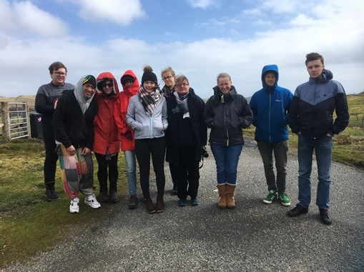
Sustainable rural development society
BSc Sustainable Development – a fully online course
Society created in 2007
Organises annual or bi-annual residential weekends in different parts of Scotland

Slide 3
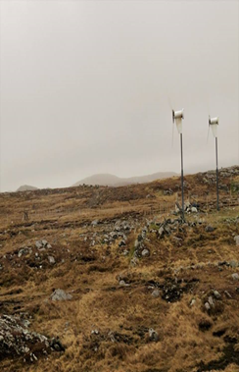
Aims of the society
Aims
To raise awareness and increase understanding of the issues surrounding Sustainable Rural Development (SRD).
To provide a platform for discussion on SRD within UHI.
To motivate members to discuss, debate and respond to policy makers' decisions/proposals.
We aim to do this by raising awareness, encouraging members to question facts and opinions and by stimulating dialogue between students, academics and professionals from the Sustainable Rural Development sector.
To provide opportunities to meet, socialise, share best study practice, and provide mutual support and encouragement.
To share resources, information and news of job opportunities, meetings and events in each of our regions.
To represent the Society at local and national level

Slide 4
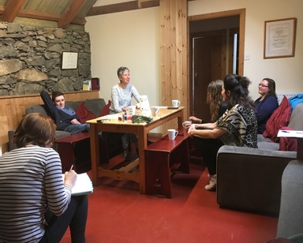
membership
“Membership shall be open to all students undertaking degree programmes within the University of the Highlands and Islands network. Membership shall also be open to Alumni of UHI and lecturing staff at the discretion of the Committee”.
In practice, membership has been made up of those taking the BSc Sustainable Development
Discussions ongoing about whether MSc SRD students and those from other programmes should be encouraged to join- especially in light of Environment and Sustainability Group formation
Committee: President, Vice-President, Secretary, Treasurer

Slide 5
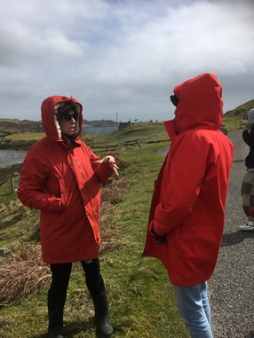
Communications
SD Induction Blackboard site
SRD Student Society Blackboard site
Announcements
Discussion Board
Collaborate
Facebook - closed group and department page
Twitter - @UHI_Sus_Dev

Slide 6
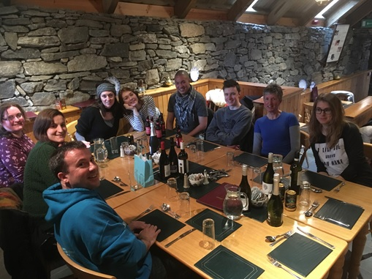
Residentials
May (and November)
In different parts of Scotland
Focus on support and bonding – student-student and student-staff
Focus on networking – with relevant employers and those working in the sector
Student-led, with support from SD staff and HISA

Slide 7
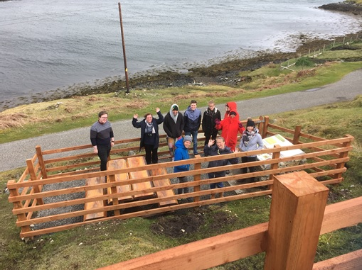
funding
HISA
LCC UHI
Bank account
Fundraising and match funding
Finding funding- an important skill for graduates in rural development!

Slide 8
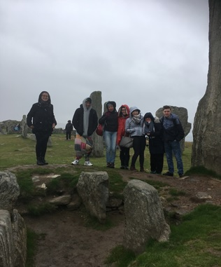
Encouraging student participation
Setting date and location early
Assessment deadlines
Providing assistance with travel, accommodation and subsistence costs
Field Studies module – 20 credits
BUT acknowledge that some students study online so they don’t have to meet face-to-face

Slide 9
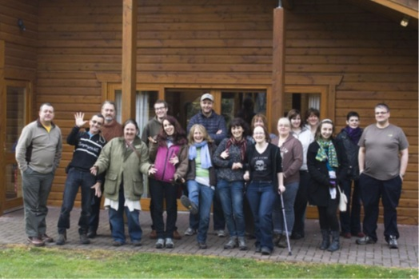
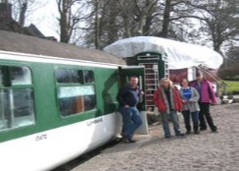
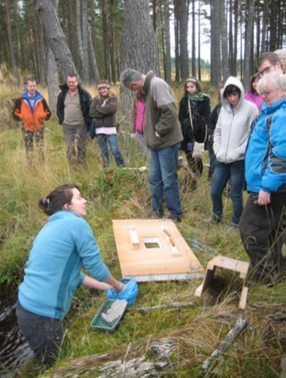
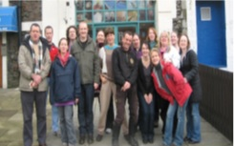
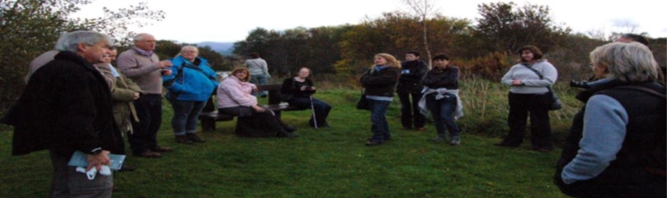
Residential trips
Rogart, Cairngorms, Skye, Harris, Lewis, Knoydart, Black Isle….

Slide 10
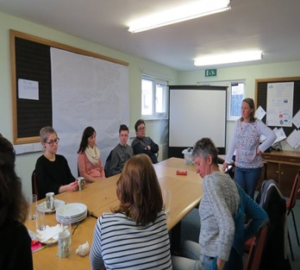
Value of residentials and student society
Building an academic community- employability and networking
This is what helps ground the course and make the theory relevant
After graduation one way or another we will use degrees in the work place. It never ceases to amaze me the diverse range of employment opportunities that are out there. Some I like and some I don't but that is human nature. Meeting these SD practitioners is also a form of networking.
This really makes the degree come alive and helps to show the wide variety of careers and opportunities after graduation. It's also a chance to raise the profile of the course (and students) with potential employers which can only help future graduates.
I have gained a lot from these trips, from invaluable advice and support to consistently interesting speakers and outings, while having a really fun weekend, and I would recommend all students to attend as many as they can.

Slide 11
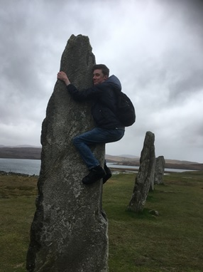
Value of residentials and student society
Building an online community – support and retention
It can feel very lonely sometimes and it helps a lot to meet others who can assure us that everything we're going through is normal and nothing to stress about.
The residentials always seem to come at exactly the right time in the semester; just as everything is starting to feel too much and I wonder if I can cope. Finding out I'm not alone is a great motivator.
Although it's only a weekend, it always feels like I've made friends with common interests and it really helps to be able to put faces to the names I see on the chat sessions each week.
It can be very lonely studying online sometimes and these residentials are so important in making us feel involved and included in the university community, and for accessing the support, academic and social, that we need to achieve our potential and continue on.

