Slide 1



UHI - LTA Connect Series
Contribution from
Amanda Mason, Lecturer
Accounting & Finance

Slide 2

The Role of AI in Modern Education cont.
Notes:
https://youtube.com/shorts/K0aTqL2dYPE?si=ynQ-pCsjhcW9Lt5o
@washingtonpostshorts

Slide 3
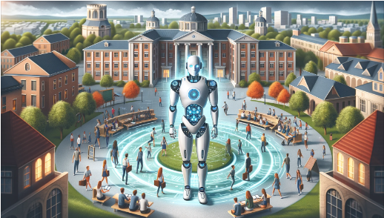
Today’s Agenda
The Role of AI in Modern Education
Case Studies and Examples
Practical Applications in Teaching
Ethical Considerations and Challenges
Interactive Session / Q&A

Slide 4

AI mind reading?
In Feb 2023, Osaka University in Japan released an academic paper where they trained an AI model to understand MRI scans.
People had MRI scans as they looked at each of the below images - outlined in red. They then took these MRI scans, fed them into the AI tool and it produced the images below – outlined in black.
4
Notes:
In Feb 2023, Osaka University in Japan released an academic paper where they trained an AI model to understand MRI scans. They got some participants to look at a lot of stock photos. They put the MRI scans into the AI machine, because they looked at tens and tens of thousands, the AI machine began to learn what an MRI scan would look like based on the shapes the colours within the photo, to the point where they then asked the participants to think of an image in their head.
The images in red are the images that they thought of. They then took the MRI scan, fed it into the AI machine and it produced the images below.
Mind reading!
We are still in the very early days of this technology

Slide 5
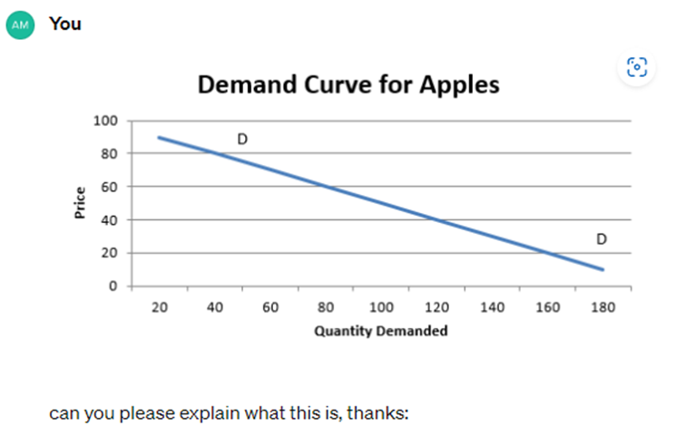
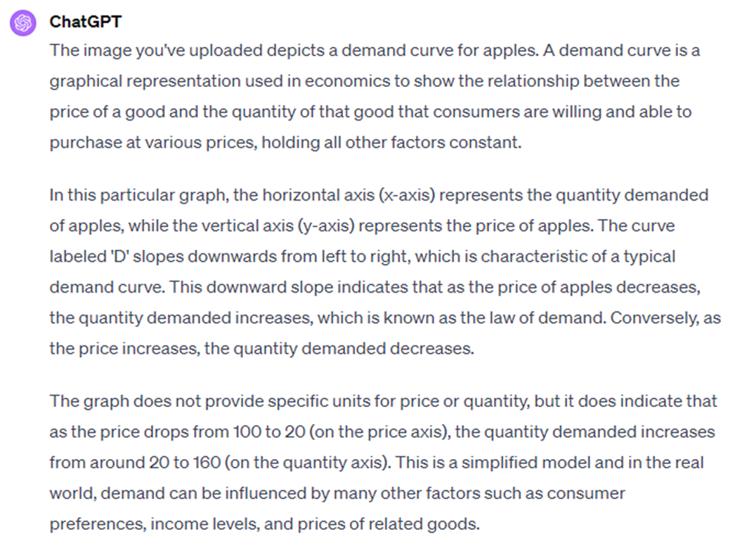


What can ChatGPT-4 do?
Can GPT-4 read a screen shot of a graph?
YES

Slide 6
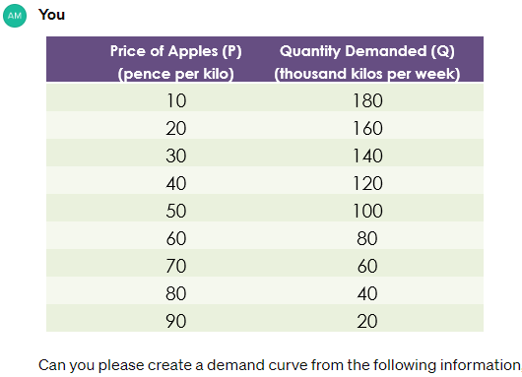
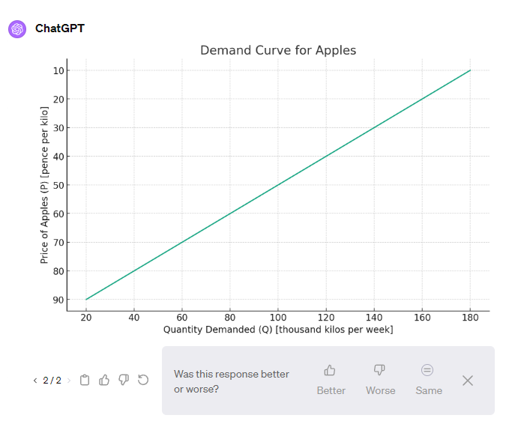



What can ChatGPT-4 do?
Not Yet!
Can GPT-4 create a demand curve graph?
Interestingly, last week GPT-4 made the same error, the price should start at zero at the bottom of the axis and increase. I instructed GPT-4 what to do and it corrected itself. This time, GPT-4 is not sure of its answer and given me an option of a response as above. The learning process

Slide 7

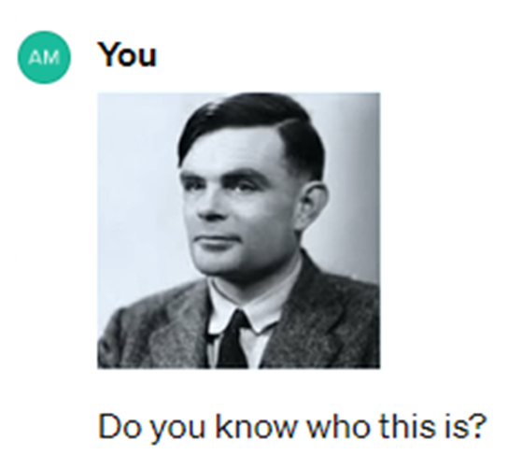



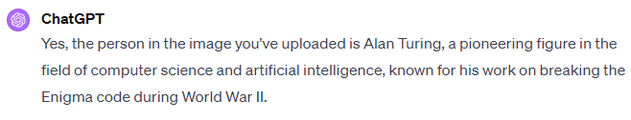

What can ChatGPT-4 do?
YES

Slide 8



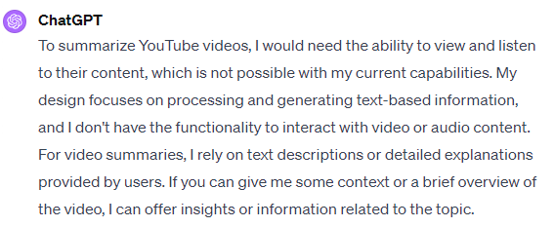
What can ChatGPT-4 do?
Can GPT-4 summarise a YouTube video?
Not Yet!
Notes:
https://youtu.be/TAhDbQk7dvc?si=VfLjSiCS7Zu5Dev9
Sam Altman Just Revealed MORE DETAILS About GPT-5 and AGI
22 Jan 2024

Slide 9
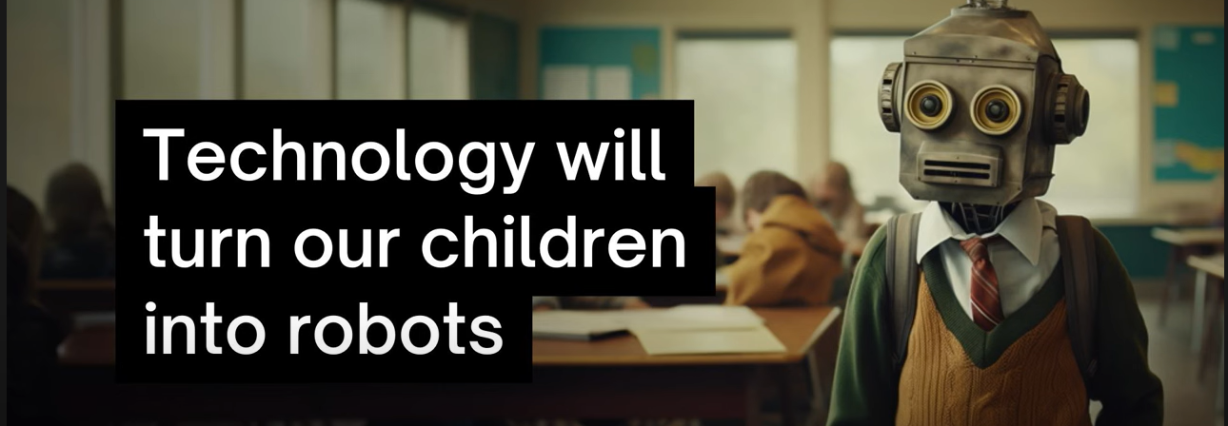
Dan thinks our education system has turned students into robots…
“We are especially good at regurgitation of information – we have been essentially training our students to be advanced level robots in an age of advanced level robots.
AI is going to change education forever. Are you ready for it? | Dan Fitzpatrick: 9th of Aug 2023
Image from above presentation
https://youtu.be/HdaNOZCK14M?si=2WwW3hvfZiOvj7kS

Slide 10


The Role of AI in Modern Education cont.
AI in Education: An Overview
Professor Ashok Goel: Georgia Tech
Jill Watson is an innovative AI teaching assistant developed at Georgia Tech
10
Image: www.techrepublic.com
Notes:
IBM Watson: The inside story of how the Jeopardy-winning supercomputer was born, and what it wants to do next
https://www.techrepublic.com/article/ibm-watson-the-inside-story-of-how-the-jeopardy-winning-supercomputer-was-born-and-what-it-wants-to-do-next/ By Jo Best, published 9 Sept 2013, updated 31 October 2022
Jill Watson, pseudonym name used for the AI that won Jeopardy.
Jill Watson is an innovative AI teaching assistant developed at Georgia Tech. It was created to assist with the online Knowledge-Based Artificial Intelligence (KBAI) class, part of the Online Master of Science in Computer Science (OMSCS) program. The system was designed to help manage the high volume of student questions in the course forums and was launched in 2016. Jill Watson was built using IBM's Watson platform, known for its Jeopardy! victory.
Jill's abilities include answering routine and frequently asked questions with a high degree of accuracy. Initially, students interacted with Jill without knowing that she was an AI, which led to some humorous reactions when her identity was revealed. Since its introduction, Jill has evolved and now operates under various pseudonyms in both online and residential sections of the KBAI class. The AI has worked alongside approximately 50 human teaching assistants and has interacted with around 1500 students.
Georgia Tech has continued to expand the capabilities of Jill Watson, including the introduction of a social AI agent to foster student connections and reduce attrition rates in online learning. This Jill Social Agent was implemented in 2019. Jill Watson has also been adapted for use beyond computer science courses, including non-CS disciplines and even for training users on ecological modelling systems.
Moreover, Jill Watson's technology has been applied to other domains, such as the SkillSync initiative, which aims to align workforce reskilling needs with educational offerings. In this context, a virtual coach named AskJill helps users navigate the platform, enhancing transparency and trust.
Jill Watson's development and the ongoing research into human-cantered AI and computational cognitive science are housed within Georgia Tech's Design & Intelligence Laboratory, led by Professor Ashok Goel​.

Slide 11

Very soon, we will have a lot of people asking this question:
Why are we sending our kids off to school?
I'm waiting for the tipping point…
When their kids could be signed up with educational places like Synthesis, they can be socialised with sports clubs and art groups etc and have play dates with their friends. If there is bullying, they move their kids to a different group 😊. If your child does not like football and prefers to swim, not an issue! Etc, etc, etc, etc, etc, etc, etc, The options for this is only going to increase as demand increases.
How will this affect Colleges and Universities?
Notes:
Parents will start their kids learning journal with programmes like Synthesis – which is a by-product of Elon Mask’s space program.

Slide 12




The
next
big thing!
Dan Fitzpatrick, is privy to see a lot of big tech developers in Silicon Valley are taking their kids out of mainstream school to put them onto courses like synthesis because they recognise that the skills, they are being taught there are not being taught in mainstream education.
Gerd Leonhard (German futurist and writer), thinks the next “Google”, the next big massive company to take over the world is going to be a private education provider.
https://etonx.com/
AI is going to change education forever. Are you ready for it? | Dan Fitzpatrick
Notes:
AI is going to change education forever. Are you ready for it? | Dan Fitzpatrick
There are going to be issues, equity will be a huge issue, because what happens when you can’t afford to put your school on an on-line school. There will be some disruption, not all going to be positive. But we will see is options. Like a menu… Parents will have options to go, you know what my daughter can go to synthesis on a Monday morning, and on an afternoon, she goes to tennis club.
Because when you present this, a lot of people go well OK, we are going to tie students to computers all day. Not at all, we need that balance and I think taking over control of that is the key.
Based on the above, initially this looks expensive, parents with deep pockets who have their children in private education, are likely to be the first to make the change and take their children out of private education. So, this is why Eton have just created Eton X, an on-line version of that school because they are trying to future proof themselves.

Slide 13

Back in 1997, Gary Kasparov was beaten by Deep Blue, and he famously said, “Chess is over”. Is it though?
Chess has never been more popular than it is today.
Because we still choose to play, we like the human interaction because human interaction is what makes us human.
Notes:
Dan Fitzpatrick: YouTube AI is going to change education forever. Are you ready for it?
Back in 1997 Gary Kasparov was beaten by Deep Blue
Chess has never been more popular than it is today! 30 second chess is a big think, children play it all over the world, it’s really popular why, when we could just watch the most amazing games we would only watch two AI machines play it. Because we still choose to play we like the human interaction because human interaction is what makes us human.

Slide 14

AI-Powered Personalisation
Data Analysis:
AI examines student data to identify how they interact with course material and where they make mistakes.
Pattern Recognition:
AI uses this data to detect trends in student performance, revealing areas of strength and weakness.
Adaptive Learning Paths:
Based on these insights, AI modifies the student's learning journey to address knowledge gaps.
Personalised Content Delivery:
AI adjusts the complexity and type of educational content according to the student's progress.
Feedback Loops:
The system refines its understanding and personalisation efforts as students engage with the content.
Resource Recommendations: AI suggests additional materials to further aid student learning where needed.
Notes:
Data Analysis: AI systems collect and analyse data from student assessments, homework, and interactions within learning platforms. This data can include correct and incorrect answers, the time taken to answer questions, and the specific types of errors made.
Pattern Recognition: Through machine learning algorithms, AI can recognize patterns in the data that indicate a student's understanding or lack thereof. For instance, if a student consistently answers a particular type of math problem incorrectly, the AI can infer a gap in understanding related concepts.
Adaptive Learning Paths: Once gaps are identified, AI can adjust the student’s learning path. For example, if a student struggles with fractions, the AI might provide additional fraction problems or reintroduce foundational concepts necessary to understand fractions better.
Personalized Content Delivery: AI can tailor the difficulty and type of content based on the student’s performance. This means that if a student is excelling, the AI might offer more challenging material to keep them engaged, while if a student is struggling, it could offer simpler, more explanatory content.
Feedback Loops: AI systems often include feedback loops, which allow them to continuously refine their understanding of student knowledge. As students interact with the new material and assessments, the AI learns more about their needs and can further personalize content.
Resource Recommendations: Beyond adjusting the existing curriculum, AI can recommend external resources, such as tutorial videos, additional reading material, or educational games that reinforce specific concepts.

Slide 15


One step further – personal AI tutor
Khanmigo is now available to the public (US only)| Personalised AI tutor & teaching assistant
Nov 2023

Slide 16




Up Learn Course Tour AQA

Slide 17

Automated Grading Systems
Content Understanding: AI examines text for key concepts and phrases as per the grading rubric.
Semantic Analysis: It evaluates the context and correct use of language in a student's answer.
Style and Structure: AI assesses writing quality, including grammar and sentence construction.
Machine Learning: AI systems improve their grading accuracy over time by learning from a large pool of graded responses and teacher feedback.
Feedback Generation: AI provides feedback, highlighting strengths and suggesting areas for improvement.
Human Involvement: Initial setup by educators is necessary for AI systems to learn grading criteria, and human review is often needed to ensure nuanced assessment.
Notes:
Written Responses:
Grading written responses is more complex and involves Natural Language Processing (NLP), a field of AI that focuses on the interaction between computers and human language.
Content Understanding: AI analyses the text to understand the content of the student's response. It looks for keywords, phrases, and concepts that should be included according to the grading rubric.
Semantic Analysis: Beyond just searching for keywords, AI can understand the context and semantics of the language used by the student. It assesses whether the student has addressed the question appropriately and has used terms and concepts correctly.
Style and Structure: Some AI systems can evaluate the structure and style of the writing, including grammar, spelling, punctuation, and sentence structure.
Machine Learning: Over time, AI systems can learn from a vast array of graded responses to improve their accuracy. Machine learning algorithms adjust the grading criteria based on teacher feedback and new data, becoming more sophisticated in evaluating written responses.
Feedback Generation: AI can also generate feedback for students, pointing out areas of strength and suggesting improvements in areas of weakness.
These AI systems require initial programming and training by humans to establish the criteria for good responses. Educators often need to review the AI's grading, especially in the beginning, to ensure its accuracy and to provide a more nuanced assessment if necessary. As the AI learns from the feedback and adjustments made by human graders, it becomes more reliable and efficient in grading written responses.
For multiple-choice questions, AI systems compare student responses with a pre-programmed answer key, which is a straightforward process. The real advancement in AI, however, comes into play when grading written responses. AI employs Natural Language Processing (NLP) to decipher written text, allowing it to analyse the quality, coherence, and relevance of student answers. This deep analysis provides insights into a student's understanding of the subject matter​​. Reference: The Evolution of Education: How AI is Reshaping Grading, The Princeton Review, The Evolution of Education: How AI is Reshaping Grading | The Princeton Review, accessed 22 Jan 2024
Multiple-Choice Questions:
AI grading of multiple-choice questions is relatively straightforward. The AI system is programmed with the correct answers, and it simply compares the student's responses to the answer key. It can handle a large volume of responses quickly and provide immediate feedback to students.

Slide 18
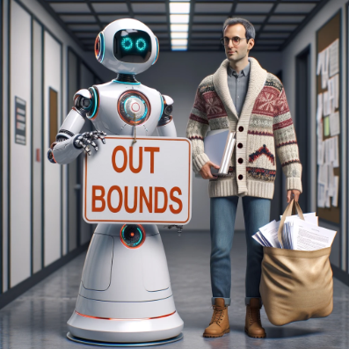
Comparing Marking Reports
Firstly, I deleted anything that could identify the student before I imputed the report into the Chatbot as per UHI inverness AI regulations.
Marking guide for that question
I prompted ChatGPT
Please grade this report with the marking scheme and show how many marks you have given to each section (note the report and marking scheme combined was too much so I had to split it up).
One of the reports questions
3) Andrew is keen to discuss his vision of the marketing focus with you at a later meeting. Provide some critical analysis around marketing processes that could be employed within the organisation, to help aid in the expansion of the firm. This would be particularly relevant from you given your experience of manufacturing products, rather than his experience of marketing services.
(15 marks available)

Slide 19
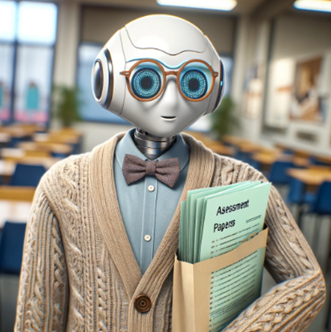




Output from ChatGPT
Results
I will provide a general evaluation of the report based on the provided marking guide. Please note that I don't have access to specific word counts or pre-seen material.
Analysis of the 4th Industrial Revolution and Digital Competencies (20/20):
The report provides a comprehensive analysis of the 4th Industrial Revolution, discussing how emerging technologies like IoT, AI, and data analytics can impact the organization. It also considers the benefits of digital adoption and the potential challenges associated with new technologies. The report covers a wide range of relevant topics and technologies, demonstrating a deep understanding of the subject matter.
Critical Evaluation of Operations and Integration with Finance (18/20):
The report discusses the merits and potential pitfalls of applying Porter's value chain, supply chain management, inventory management, and quality management theory to support the expansion of operations. It also touches upon sustainability issues and process technology. However, it could benefit from more specific examples or case studies related to the manufacturing industry.
Critical Analysis of Marketing Processes (13/15):
The report discusses various marketing processes, including market segmentation, market research, the marketing mix, digital marketing, and the use of social media. It provides a good overview of marketing strategies that can aid in the expansion of the firm. However, it could offer more specific insights into how these strategies can be applied within the manufacturing sector.
18/20
18/20
12/15

Slide 20








Evaluation of Recruitment and Retention of Staff (14/15):
The report provides a comprehensive discussion of the recruitment process, including job analysis, job descriptions, and person specifications. It also touches upon selection methods, contemporary HR issues, and the role of management and HR. The addition of Green HR theory would have been beneficial, but overall, it offers valuable insights into HR practices.
IT Improvement and Finance Function (13/15):
The report discusses the enhancement of knowledge management through the use of Management Information Systems. It also mentions IT infrastructure and KPIs. However, it could provide more specific recommendations for improving the organization's limited IT function, and how the Finance function can aid in shaping IT decisions.
Presentation (5/5):
The report is well-structured, using appropriate formatting and language. It maintains a professional and academic tone throughout, and the layout is clear and readable.
Referencing (9/10):
The report uses a consistent Harvard referencing style, and the list of references is well-structured. However, there could be slightly more references to support the information, especially in the sections related to the 4th Industrial Revolution and IT improvement.
Overall, the report provides a thorough analysis and critical evaluation of various aspects of the organization's expansion, incorporating relevant theories and models. It offers valuable insights into how the organization can leverage technology and implement strategies for growth.
13/15
15/15
5/5
8/10
Agreed second markers Total 89
ChatGPT Total 92

Slide 21

Assessment Feedback
I prompted
Please create some overall feedback for the student
In summary, your report demonstrates a deep understanding of the topics discussed, and your use of theories and models is commendable. To further enhance your work, consider providing more specific examples or case studies relevant to the manufacturing sector, and offer practical recommendations for the organization's unique needs. You've done a great job overall, and your insights will undoubtedly provide valuable guidance to the management team.
Note, within the feedback offered above, it had included the feedback already given in the prior slide, so I left that out because I would have already used this in Brightspace – maybe with some minor changes and put the below in the Overall Feedback section

Slide 22
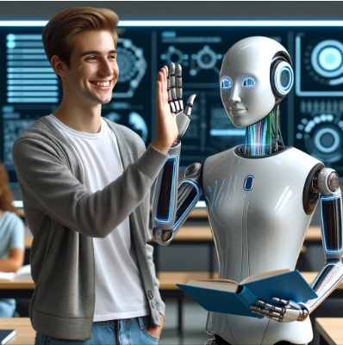
I have seen this type of
encouraging feedback
from a Chatbot 💟
It's great to see that you are trying to improve your writing skills, don't get discouraged if you don't see immediate improvement. Writing is a skill that takes time to practice and develop. Remember that it's okay to make mistakes and that asking for help is normal and an important part of the learning process. If you ever need help or have questions, I'm here to support you and provide guidance. Keep working hard and don't be afraid to try again. I know you have the potential to succeed

Slide 23
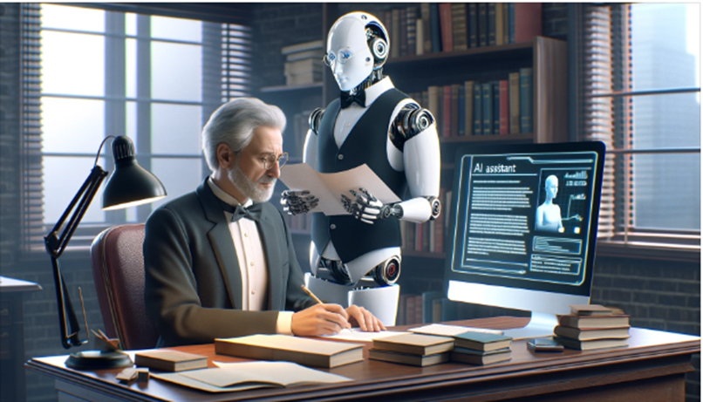
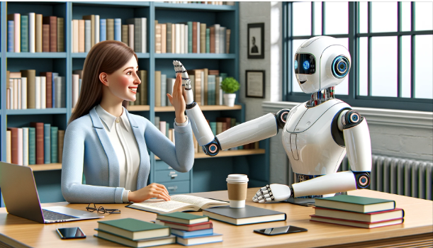
Automated Grading Systems
In summary, I have found that AI has helped with my marking, mostly in aiding with feedback.
Image by Dell-E
It is important to balance the use of AI with human oversight to ensure that the nuances of student work are captured and that the feedback provided supports holistic educational goals.
Image by Dell-E
Notes:
In summary, AI grading tools can significantly ease educators' administrative burdens and provide a more efficient, consistent, and personalized learning experience for students. However, it is important to balance the use of AI with human oversight to ensure that the nuances of student work are captured and that the feedback provided supports holistic educational goals.
Reduction of Educators' Workload: AI grading tools can significantly reduce the time educators spend on grading assignments and exams. For instance, the use of AI in tools like Gradescope has been shown to reduce grading time by up to 90%. This efficiency gain comes from AI’s ability to learn and recognize patterns in student answers, allowing educators to grade batches of similar responses simultaneously. It also reduces the repetitive and manual aspects of grading, freeing up educators to focus on more interactive and high-value teaching activities​​. https://developer.nvidia.com/blog/artificial-intelligence-helps-grade-exams-90-faster/
Timely Feedback for Students: With the help of AI, feedback can be generated almost instantly after students complete their assignments. This immediacy helps students to quickly understand their mistakes and grasp the correct concepts while the material is still fresh in their minds. Timely feedback has been linked to improved learning outcomes as it allows students to adjust their learning strategies promptly and effectively​​​​. https://www.benzinga.com/guides/software/best-ai-tools-for-education/ & https://www.classpoint.io/blog/best-ai-tools-for-teachers
Consistency in Grading: AI tools provide a level of objectivity and consistency in grading that can be challenging to achieve manually, particularly with large class sizes. This ensures fairness and equity in the assessment process and minimizes potential biases that may occur with traditional grading methods.
Data-Driven Insights: These tools often come with analytics features, providing educators with insights into common errors or misconceptions among their students. Such data can inform future instructional strategies and help educators identify which areas of the curriculum may need more attention or different teaching approaches​​. Top 4 Best AI Tools for Education in 2024 - Benzinga Guides
Personalized Learning: AI can analyse individual student performance to tailor feedback, thereby supporting personalized learning paths. It can identify each student’s strengths and weaknesses, allowing educators to provide targeted support where needed and to customize instruction to better meet individual learning needs​​. 7 Best AI Tools For Teachers That Will Save You Time in 2024 | ClassPoint

Slide 24
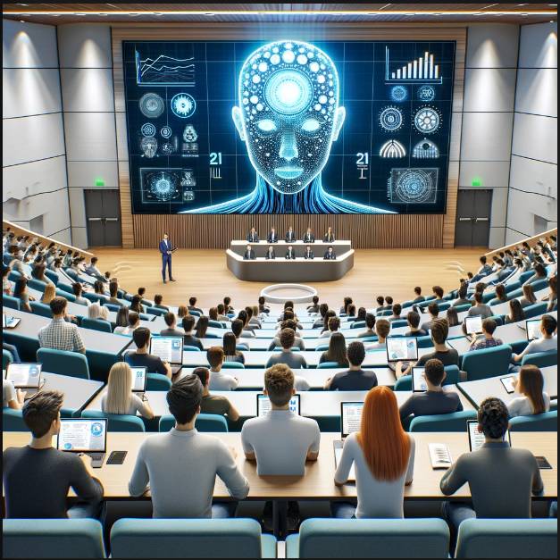
The Role of AI in Modern Education cont.
Interactive Learning Experiences
Querium, which use AI to provide step-by-step tutoring in STEM fields.
AI creating simulations and games that engage students in complex problem-solving activities.
AI in virtual labs, allows students to conduct experiments in a safe and controlled digital environment.

Slide 25

Warning about ‘Engagement’
Must have a chat about a conversation between Donald Clark & Brian Mulligan,
from their ILTA Fireside Tech Talks: Generative AI and Education Innovation
Recently, I delivered a 101 Economics class to first year college students. Some were motivated in their learning, others not so much !
I used ChatGPT to help me create some gamification ideas for the classroom so it would increase all student's engagement and therefore make learning easier… hoping they would mostly pass!
I was wrong… it did increase student engagement but had very little effect on their understanding of the topics and therefore little effect on their assessment results.
Would I use gamification again in class? Yes, but it would be about 15% of class time. Most students liked the games which meant they came to class knowing they would have some fun.
But ‘student engagement’ means something different to me now and hearing Donald Clark relating engagement to seeing a much-enjoyed comedy show and then being asked afterwards to tell one of the jokes? Engagement does not necessarily mean a learning experience
Engagement does not necessarily mean a learning experience

Slide 26


Interactive Learning Experiences
StepWise for Math Word Problems Using SRSD
Personalised Learning
Interactive Tutoring
Step-by-Step Guidance
Immediate Feedback
Performance Monitoring
Increased Accessibility
Bridging Educational Gaps
Notes:
Personalized Learning: AI platforms like Querium adapt to individual learning styles and pace, customizing the difficulty of problems to optimize student engagement and understanding.
Interactive Tutoring: These systems offer real-time problem-solving assistance with hints and feedback, mimicking the support of a human tutor.
Step-by-Step Guidance: Complex STEM problems are broken down into manageable steps to aid learning and confidence, essential for subjects requiring sequential problem-solving.
Immediate Feedback: Students receive instant responses to their work, enabling faster learning and maintaining high engagement levels.
Performance Monitoring: Dashboards for students and educators track progress, highlighting areas of strength and those needing improvement for targeted support.
Increased Accessibility: Accessible anywhere with an internet connection, AI tutoring makes high-quality STEM education available to more students, including those without resources for private tutoring.
Bridging Educational Gaps: By providing interactive, accessible, and personalized learning experiences, AI platforms are transforming STEM education, making it more equitable and effective.
References:
ClassPoint (2024): Analysis of AI Tools for Teachers.
NVIDIA Developer Blog (2016): AI's Role in Grading Efficiency.
Benzinga Guides (2024): Review of Top AI Education Tools.

Slide 27

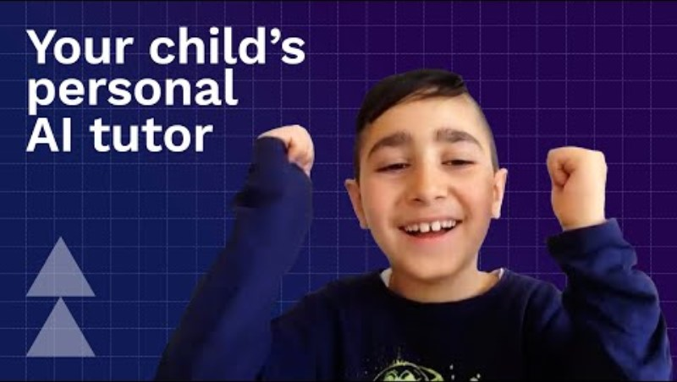
Interactive Learning Experiences
AI creating simulations and games that engage students in complex problem-solving activities.
For example, Synthesis provides a platform that originated from an experimental school started by Elon Musk at SpaceX.
It aims to develop students who are enthralled by complexity and skilled in solving unknown problems. Synthesis uses games to help students develop strategic thinking and collaborative problem-solving abilities​​. Synthesis
Your Child’s Personal AI Tutor | Synthesis
Notes:
AI is increasingly being integrated into educational simulations and games, transforming the way students engage in complex problem-solving activities across various subjects, especially in STEM education.
For example, Synthesis provides a platform that originated from an experimental school started by Elon Musk at SpaceX. It aims to develop students who are enthralled by complexity and skilled in solving unknown problems. Synthesis uses games to help students develop strategic thinking and collaborative problem-solving abilities​​. Synthesis
The CoDeAI project is another initiative that emphasizes the integration of AI into higher education curricula through simulation-based learning. It offers students immersive learning environments and practical experiences by allowing them to work on real-world challenges within simulated scenarios, thereby bridging the gap between theoretical knowledge and practical application. This helps students to not only grasp AI concepts but also to apply them in real-life situations​​. https://ied.eu/blog/education-blog/simulation-based-learning-ai-education/ Revolutionizing AI Education With The Power of Simulation-Based Learning, by Vasilis Bouronikos, 26th June 2023

Slide 28

AI in Education: An Overview – Interactive Learning Experiences
AI in virtual labs,
allows students to conduct
experiments in a safe and controlled digital environment.
AI-driven virtual labs represent a significant advancement in STEM education, providing safer, more accessible, and cost-effective ways to enhance the practical learning experience in higher education settings.
This virtual lab will revolutionize science class | Michael Bodekaer
11.26 minutes
Notes:
Simulating Complex Systems: AI allows for the safe and accurate simulation of biological, chemical, and physical systems, enabling students to engage with otherwise inaccessible processes.
Adaptive Learning: Personalized experiment adaptation based on student actions, with AI guidance similar to a lab instructor's assistance.
Predictive Modelling: AI predicts experimental outcomes, providing instant feedback on students' hypotheses, enhancing their understanding of scientific concepts.
Data Analysis: AI efficiently processes large datasets from virtual experiments, aiding students in deriving conclusions without manual data processing.
Safety and Accessibility: Virtual labs ensure a risk-free learning environment, essential when working with hazardous materials, and improve accessibility for students with disabilities.
Encouraging Exploration: The non-hazardous environment of virtual labs promotes fearless experimentation among students.
Cost-Effectiveness: Virtual labs reduce the need for physical materials and space, offering a scalable, budget-friendly learning tool for institutions.
Integrating Theory and Practice: AI-driven labs integrate theoretical learning with practical application, providing real-time theoretical context during experiments.
Conclusion: AI-driven virtual labs represent a significant advancement in STEM education, providing safer, more accessible, and cost-effective ways to enhance the practical learning experience in higher education settings.

Slide 29


'Metaverse school' teaches students using VR
June 2023
2.38 min
Notes:
AI in virtual labs can provide meaningful, immediate feedback to students, which is especially beneficial for those who might feel uncomfortable taking risks or receiving feedback in a classroom setting. This encourages a more explorative approach to learning, allowing students to make mistakes and learn from them in a controlled digital environment. Additionally, AI can personalize the learning experience by adapting to each student's individual needs, providing customized support and instruction based on their learning style and pre-existing knowledge​​.
Furthermore, universities are beginning to reimagine teaching labs for a virtual future, ensuring that students can gain hands-on industry experience regardless of their physical location. Advanced virtual lab options allow students to access industry-grade lab equipment remotely, providing real-time guidance and feedback from instructors. This move towards virtual labs represents the beginning of a significant shift in how practical STEM education is delivered, expanding access and removing traditional limitations​​.
Overall, the integration of AI into virtual labs is transforming the way STEM education is delivered, making it more accessible, efficient, and adaptable to the diverse needs of students.
AI is increasingly integral in the realm of virtual labs, especially in STEM education. These virtual labs use AI to create realistic simulations where students can perform experiments that might be too risky or expensive to conduct in a traditional lab setting. The advantages of using AI in virtual labs are manifold:
AI can significantly reduce human error and increase the accuracy of experiments by following a set of algorithms and utilizing the previously collected information.
Virtual labs are available around the clock, allowing for more flexible learning schedules.
The risk to students is minimized as AI can undertake dangerous tasks or simulate such conditions without any real-world risk.
Repetitive and time-consuming tasks can be automated, enabling students to focus on the learning aspect of the experiment.
AI can handle routine jobs efficiently, allowing educators to devote more time to personalized teaching and learning interventions.
Inspired Education Becomes First to Launch Metaverse School With Ground-Breaking Vr Technology
https://www.inspirededu.com/news/inspired-education-becomes-first-launch-metaverse-school-ground-breaking-vr-technology
22 March 2022

Slide 30

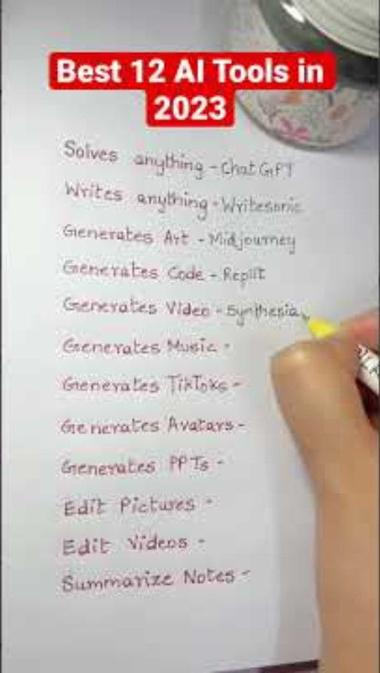

The Role of AI in Modern Education cont.
Common AI Tools and Platforms
Times are changing, after an investigation into the most common AI tools and platforms, the below two came up:
Socrative, has had very little traction in multimedia, so clearly on the way out…
Content Technologies, Inc (CTI), gone! Web domain is available.
Notes:
AI Tool Example 1: Socrative
Function: Real-time assessment tool which allows teachers to create quizzes and games that students can participate in via smartphones, tablets, or computers.
Use in Classrooms: Engages students through interactive assessments that provide immediate feedback to both students and educators.
Benefits: Helps teachers to quickly gauge student understanding and adjust lesson plans accordingly.
AI Tool Example 2: Content Technologies, Inc. (CTI)
Function: Uses deep learning algorithms to create customized educational content, including textbooks and syllabi.
Use in Classrooms: Provides teachers with tailored materials that are aligned with their lesson plans and student needs.
Benefits: Saves time for educators in lesson planning and offers materials that cater to varied learning styles.
Kahoot and Socrative are both popular tools used in higher education for formative assessment. Kahoot is known for its game-based, highly engaging quizzes that can make learning fun and active, but its time-bound nature might lead to hurried responses from students. Socrative, while not as visually engaging as Kahoot, is praised for its focus on assessing students' understanding of topics and its comprehensive reporting features that provide instant, actionable feedback to educators. Socrative allows for a more in-depth collection of assessment data, making it a strong choice for educators who prioritize data-driven instruction (Teachnet.ie).

Slide 31
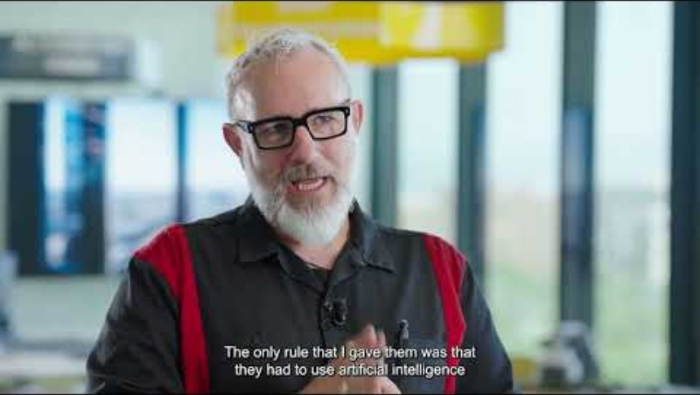
The Role of AI in Modern Education cont.
Case Studies and Examples
Professor Brian Hallett
AI for Education | Using AI Critically in the Classroom
1.21 min
7th of Aug 2023
Notes:
AI for Education | Using AI Critically in the Classroom 7 Aug 2023
https://youtu.be/Uriw6oziM_Q?si=GwGJYaGgMXqO6gl7 Professor Brian Hallett
Join Professor Brian Hallett, an expert in Visual Communication and Branded Content, as he unveils the transformative power of AI in education at IE University. Discover how IE University empowers students to embrace AI as a valuable tool for creativity and critical thinking. Witness real-life examples where AI enhances students' inventions and analyses, raising the bar for excellence. Experience the future of personalised learning, where AI and humans collaborate to create a dynamic and enriching academic environment.

Slide 32

The Role of AI in Modern Education cont.
Case Studies and Examples
Georgia school district brings AI into K-12 classrooms
6.32 min
28 Aug 2023
Notes:
https://youtu.be/1n1MxBGvb2U?si=z695R0uTyY7xdAjj
Georgia school district brings AI into K-12 classrooms 28 Aug 2023

Slide 33

Practical Applications in Teaching
Using AI in the writing classroom: Laura Dumin
15.06 min
16 March 2023
Incorporating AI in Classrooms
Notes:
https://youtu.be/01bFiWWVHss?si=CIYkqaw4BDpmV3lo
Using AI in the writing classroom: Laura Dumin 16 March 2023

Slide 34

Practical Applications in Teaching
Incorporating AI in the classroom
Student led assessment in an AI enhanced classroom
Hazel Farrell
14.45 min
Dec 2023
Notes:
Student led assessment in an AI enhanced classroom - Hazel Farrell
https://youtu.be/rqxvQANMruM?si=6JTODQxXEG0kvzLg 7 Dec 2023

Slide 35

Ethical Considerations and Challenges
Ethical Implications "Using AI responsibly in education means considering..."
Bias and Fairness:
  AI systems to be free from biases that could affect the fairness of educational outcomes, including careful design to avoid racial, gender, or socioeconomic biases.
Transparency:
  Importance of transparency in AI algorithms so that decisions made by AI can be understood and questioned by educators and students alike.
Data Privacy:
  Paramount importance of protecting student data privacy, with adherence to regulations like GDPR for European students and FERPA in the United States.
Informed Consent:
  Necessity of obtaining informed consent from students and parents before using AI systems that process personal data.
Security:
  Need for robust cybersecurity measures to protect educational AI systems from unauthorised access and data breaches.
AI is not always right, consider the above spelling
Image by Dell-E

Slide 36

Alleged Copyright Infringement Court Case
Open AI in conjunction with Microsoft is being sued by The New York Times for alleged copyright infringement.
The New York Times are claiming that Open AI trained it’s full GPT-4 model on many different New York Times articles, and they essentially want GPT-4 to be shut down.
Open AI sells access to GPT-4, however GPT-3.5 is given freely at this point.
For example, look at one of the many articles New York Times has put forward, the left-hand-side came from GPT-4, and the right-hand-side came from NY Times. We don’t have the whole article, but we can clearly see that only one word has changed and if this was two students work, I would call it ‘plagiarism’,
Big Oopsy!
1 Jan 2024
Notes:
Open AI Is In SERIOUS Trouble (Open AI Lawsuit Details) 1st Jan 2024
https://youtu.be/oXh84-0uO1A?si=Qo-hQlKAFVnqbBXA

Slide 37

Is AI a Dragon or a Knight?

Slide 38

Notes:
Cheating or Learning? Walking the AI tightrope in education | Erik Winerö | TEDxGöteborg
TEDx Talks - Dec 2024
https://youtu.be/mEtAfbFr6RE?si=ezkpKF0qKE2kxNxS

Slide 39


Naughty!
Dialogue testing for understanding
Students have always been able to cheat with unsupervised assignments. This not a new problem
It’s not hard to avoid this issue by changing the way we assess students.
Teach underpinning knowledge and how to use AI to create reports etc. Then ask the students to discuss their process and question them about their work to get a gauge of their understanding.
That’s their assessment.
This is also in alignment with future employment
Notes:
https://youtube.com/shorts/ObMnw8woAog?si=JCXbKV2CI1M39RO9
https://youtube.com/shorts/K7z0jlE61IM?si=dO713DOXbdK-soy3

Slide 40
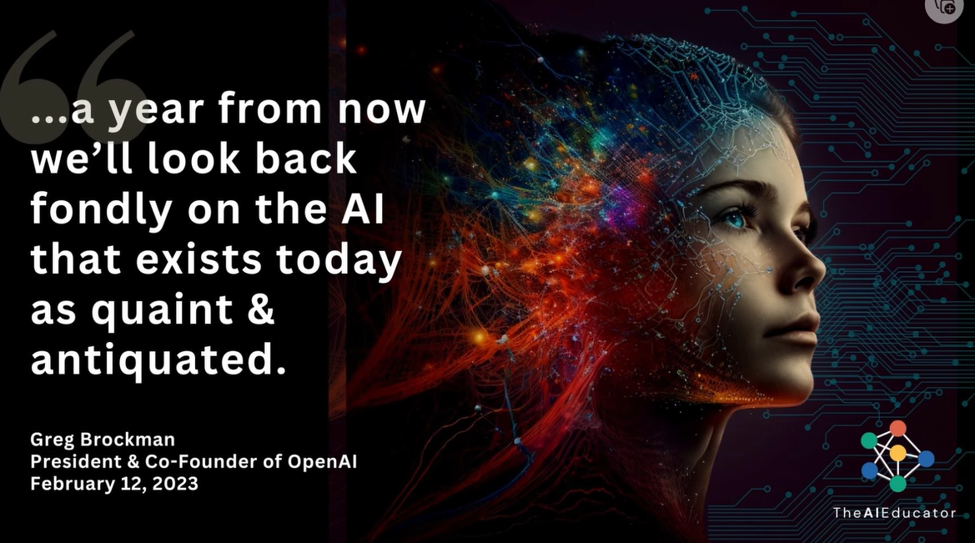

Slide 41
Interactive Session / Q&A
Experience Sharing
  "I would love to hear about your experiences or concerns with using AI in education.“

Slide 42

Thank you

