Slide 1
Embedding Scholarly activity into practice – presenting your work
Sara Smith
Assistant Professor in Biomedical Science
Division of Medical Sciences & Graduate Entry Medicine
School of Medicine

Slide 2
Can we define scholarly activity?
What does the term Scholarly Activity mean to you as an individual and do you already do Scholarly Activity or something that could be classed as Scholarly Activity?
What are the barriers/challenges to engaging with Scholarly Activity?
What are the benefits for you and your practice with engaging with Scholarly Activity and disseminating your work?

Slide 3
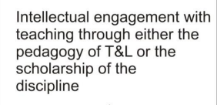
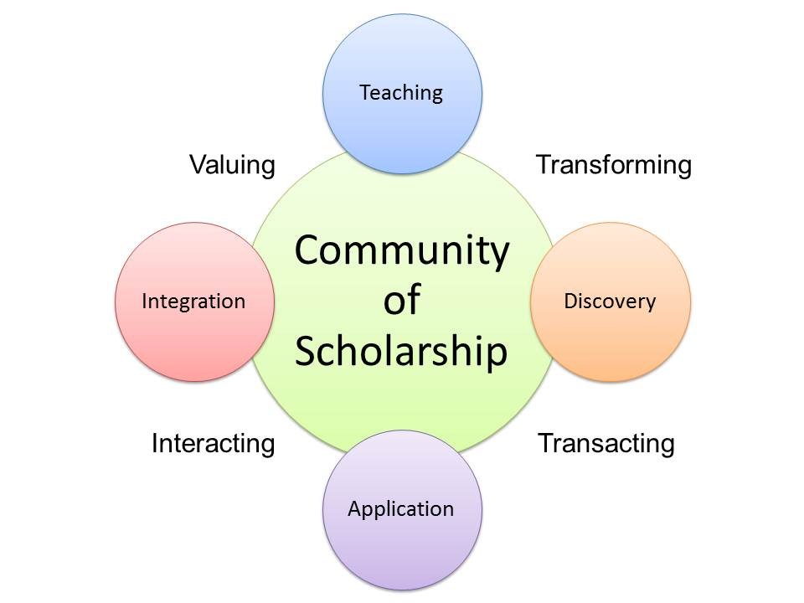
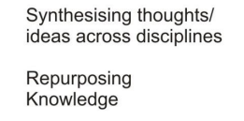
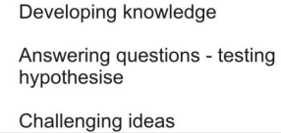
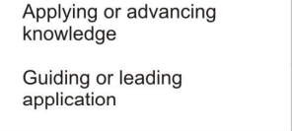
Boyer’s model of scholarship

Slide 4
Dearing (1997) - Research is central to economic prosperity
Intertwined characteristic of an undergraduate education
Contribute to lecturers’ identity
Contribute to students’ development
Contribute to institutional ethos
Notes:
Key aspect for us : It makes you think about and reflect upon what you do! This helps you to put the pieces together….
What is it you want to know…?
Why do you want to know it…?
How will you use the findings?
What next…?

Slide 5

My journey so far…………………….
Pixabay

Slide 6

Background
Smith, S. (2010) To blog or not to blog: supporting the development of critical reflection The Biomedical Scientist (June) p428-429
Professional Doctorate – Educational Enquiry
BSc Biology
16 years NHS – Biomedical Scientist. Manager at Birmingham Cytology Training Centre
12 years Senior lecturer/Assistant Professor in Higher Education
MSc Biomedical Science
PGCert Managing Health Services
PGCert Medical Education
(Pixabay)

Slide 7

Starting on my journey…..
Main drivers for undertaking scholarly activity:
  Personal development as a teacher
  Am I providing an appropriate learning environment for my students?
  What can I do to improve the experience for both my students.…and myself!!
Outcomes from undertaking scholarly activity:
  Collaboration with colleagues – developed a network of support
  Increased job satisfaction
  EdD
  Sharing and publishing findings – improving practice

Slide 8
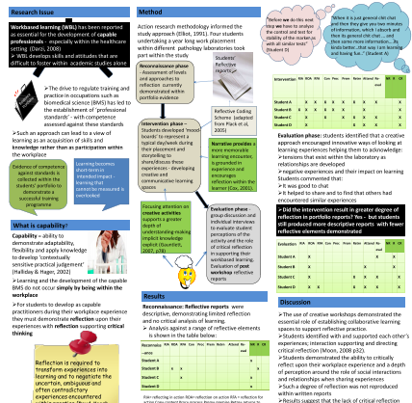
My initial steps
Smith, S. (2010) To blog or not to blog: supporting the development of critical reflection The Biomedical Scientist (June) p428-429
Conference presentation
Smith, S. (2013) “Developing Practitioner Capability during Work based Placement: supporting creative interactions” - Enhancing Employability through Placements Conference , The University of Huddersfield, Business School - Tuesday 9th July 2013
Conference poster
Smith, S. (2013) “Developing practitioner capability: do students reflect? “ BERA Annual Conference 3-5th September, 2013 University of Sussex. Awarded Prize - Best Early Career Researcher Poster
Paper
Smith, S. and Martin, J. (2014) "Practitioner capability: Supporting critical reflection during work-based placement – a pilot study", Higher Education, Skills and Work-based Learning: 4 (3) pp.284 - 300

Slide 9

Building scholarly activity into your work…..
Flipping!!!!!
Basic Flip
Enhanced Flip
Augmented Flip
Basic Flip
Smith, S. (2014) Flipping the Postgraduate Classroom. BERA Annual Conference, IOE, London - Presentation
Smith, S., Brown, D., Purnell, E. and Martin, J. (2015) ‘Flipping’ the Postgraduate Classroom: supporting the student experience. In: Global Innovation of Teaching and Learning in Higher Education. Transgressing Boundaries. Eds Layne, P. and Lake, P. Series: Professional Learning and Development in Schools and Higher Education, Vol. 11. Springer Publishing International
Smith, S. (2016) “Flipping the Practice Based Classroom” Inspire to Succeed: Transforming teaching and learning in Health and Social Care, HEA - 24 & 25 February 2016 - Poster
Smith, S., Ganesan, R. & Martin, J. Flipping The Practice Based Pathology Laboratory—Can It Support Development Of Practitioner Capability For Trainee Pathologists in Gynaecological Cytopathology?. J Canc Educ 32, 662–668 (2017)
Enhanced Flip
Smith, S. and Khechara, M. (2016) ‘Technologizing’ the Postgraduate Classroom. Proceedings of EDULEARN16 Conference 4th-6th July 2016, Barcelona, Spain ISBN: 978-84-608-8860-4 Conference proceedings
Smith. S. and Khechara, M. P. (2018) ‘Technologizing’ the postgraduate classroom. In; Transition: in through and out of higher education. In; Transition: in through and out of higher education: International Case Studies and Best Practice. Eds. Matheson, R., Tangey, S. and Sutcliffe, M. Routledge
Augmented Flip
Smith, S. and Khechara, M, (2017) Using Augmented Reality to Enhance the Student Laboratory Experience. Proceedings of EDULEARN17 Conference 3-5th July 2017, Barcelona, Spain ISBN: 978-84-697-3777-4 Conference proceedings
Khechara, M. P. and Smith, S. (2018) Creating Time and Responsive Dimensions in Science with Mobile Technology – In; Mobile learning in higher education: Challenges in Context. Eds. Traxler, J & Crompton, H. Routledge, New York
Smith S., Khechara M. (2020) Flipping Biomedical Science. In: Walker Z., Tan D., Koh N. (eds) Flipped Classrooms with Diverse Learners. Springer Texts in Education. Springer, Singapore. https://doi.org/10.1007/978-981-15-4171-1_14
Pixabay

Slide 10

Sharing your findings……
Conference Poster?
Paper presentation?
Publication?

Slide 11

Evaluating scholarly activity and embedding into your discipline
Methodology?
Methods?
Quantitative vs Qualitative
Tools ?
Questionnaire
Assessment outcomes
Focus groups
Interviews
The theory of how we gain knowledge and why. This will dictate the methods selected and the tools used
How you collect, analyse and interpret the data
Pixabay

Slide 12
Why present and publish?
To exchange ideas
To build reputation
To disseminate work on a global scale
Remember:
Your research is not complete until it has been shared!!!
Language and structure are critical
Choose the right conference or journal!!!

Slide 13
Where to get started….?
HESWBL
BERA –
Ethics - useful resources
Notes:
Book chapters etc

Slide 14

Peer support and Collaborations
DATES FOR YOUR DIARY
31.07.20 Paper submission ends
22.08.20 Review results announced
07.09.20 Ticket sales open
10.09.20 Presentation times announced
09.11.20 Registration deadline
IMAGINING THE POST-PROFESSIONAL
IDENTITY, ETHICS AND RESPONSE-ABILITY BEYOND PROFESSIONAL STANDARDS
27-28th November, 2020
https://ipda.org.uk/
https://ipda.org.uk/26-nov-2020-ipda-pre-conference-early-careers-researchers-and-doctoral-forum/

Slide 15

Questions?

