Slide 1
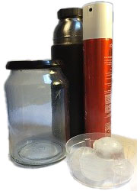

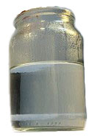
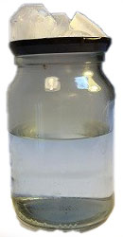

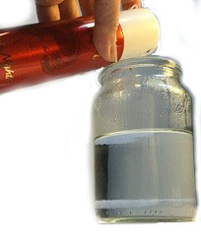

Carefully pour the hot water into the glass jar, fill it about half full.
Spray a generous squirt of hairspray into the glass jar, above the hot water.
Place the lid upside down on the jar and add some ices cubes on top.
Watch the top half of the jar, can you see a cloud?
Unsure – try removing the lid to let the cloud out!
Cloud in a bottle
How to get water molecules to form a cloud.
What you need
• Glass jar with lid • Hot water • Hairspray • Ice-cubes
The Science
1.
Carefully pour the hot water into the glass jar to about half full.
3.
Place the lid upside down on the jar and add some ices cubes on top.
For a cloud to form there must be three things, water molecules, dust, and a change in temperature of pressure. There are water molecules all the time in the air around us bouncing around, but in a cloud, these stop bouncing and stick together. This is caused by the ‘cloud condensation nuclei’ such as dust or pollution particles combined with a change in temperature or pressure. Real clouds form when warm air rises in the atmosphere, meets dust particles, and cools down. Clouds are more likely to form when it's cold.
When you add the hairspray, you are polluting the air above the hot water. The ice cubes on the metal lid slowly change the temperature of the air beneath the lid, so the temperature inside the top of the bottle falls and the water molecules condense, becoming visible. The hairspray particles act as cloud condensation nuclei, allowing the water molecules to condense and stick together forming the cloud in a bottle.
.
2.
4.
Watch the top half of the jar, can you see a cloud? Unsure – try removing the lid to let the cloud out!
Spray a generous squirt of hairspray into the glass jar above the hot water.

