Slide 1

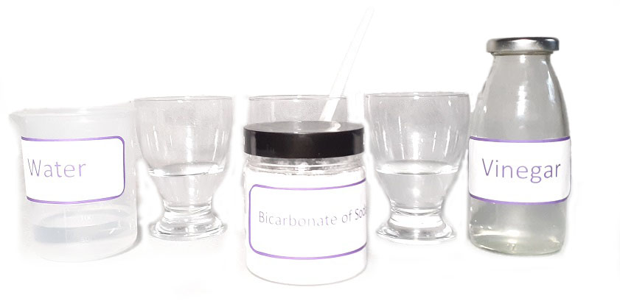

Magic chemistry
Use the magic of science to change the colour of solutions.
What you need
•Red cabbage leaves • Hot water • Jar • Sieve • 3 Glasses • Water • Vinegar • Bicarbonate of Soda • Spoon
1.
Make the Universal Indicator.
Rip up the cabbage leaves and place in a container of hot water. Leave for 10-15 minutes then strain the solution into a jar and throw away the leaves. This is your Universal Indicator.
3.
Add about 1cm of water to glass 2 and mix with the bicarbonate of soda. You now have three glasses with 1cm of solution, which all look the same.
5.
Add two spoons of universal indicator to glass 2 and watch what happens.
2.
Lay three glasses in a row: 1,2,3.
Pour about 1cm of water into glass 1, spoon
in a small amount of bicarbonate of soda into glass 2 and pour about 1cm of vinegar into glass 3.
6.
Add two spoons of universal indicator to glass 3 and watch what happens.
4.
Add two spoons of universal indicator to glass 1 and watch what happens.

Slide 2
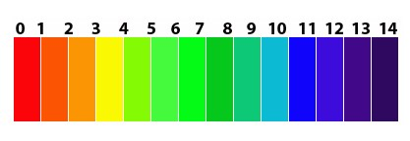
The Science
What has happened?
A universal indicator is a pH indicator composed of a solution of several compounds that exhibits several smooth colour changes over a pH value range from 0 to 14 (it may be negative or higher depending on the concentration) to indicate the acidity or alkalinity of solutions, where 7 indicates neutral.
The solutions in the glass react with the Universal Indicator depending on their pH and undergo a change in colour.
Water is neutral with a pH of around seven. There is no colour change but a dilution of the universal indicator, and it might appear a lighter shade.
The bicarbonate of soda solution is a weak alkali with a pH of around nine, so the solution changes to a weak blue or green.
Vinegar is an acid with a pH or around five so the solution changes to a pinkish red.
Red cabbage contains a chemical called anthocyanin. The chemical is blue in its neutral state, which is why the cabbage water will be blue after the cabbage steeps for a while. Anthocyanin will turn red when mixed with an acid and a greenish colour when mixed with a base.
pH scale

