Slide 1
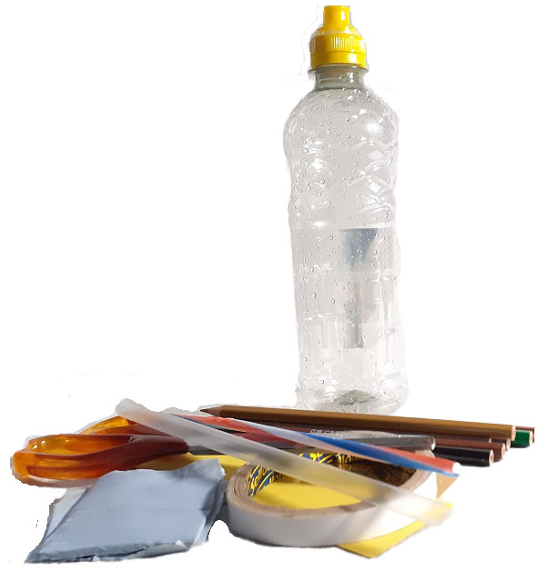

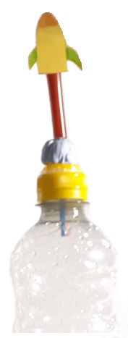
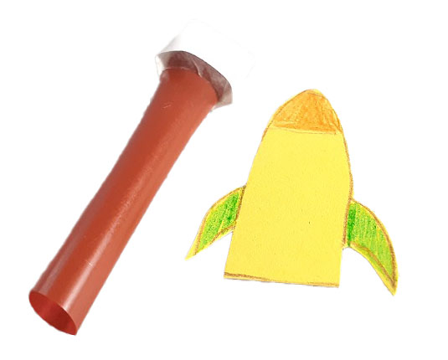
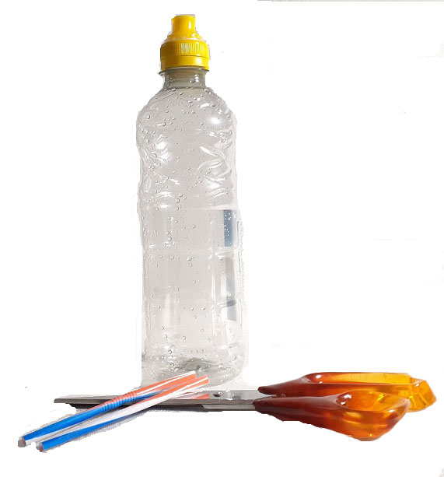
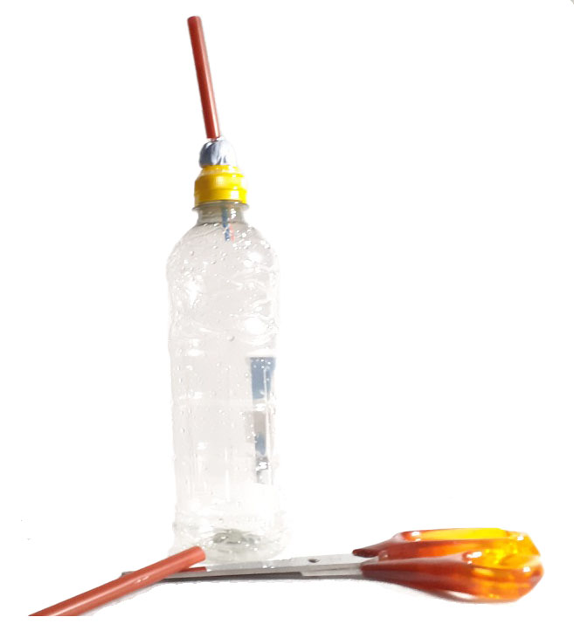
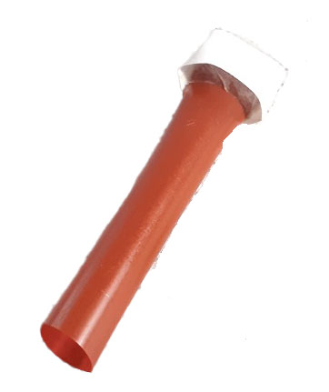
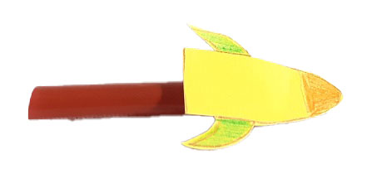


Rocket Science
Make you own rocket out of recycled materials.
What you need
• Sports water bottle • Blue Tac • Sellotape • Cardboard • Coloured pencils • Straws (two different sizes) • Scissors
1.
Make your rocket launcher.
Open the sports cap, cut the narrower straw in half and push half of the straw into the bottle through the hole in the water bottle top. Mould Blue Tac around the straw securing it and making an airtight seal. Squeeze the bottle to make sure air comes out of the straw and not from the sealed sides.
3.
Make your rocket
Using the 2nd straw as a size guide, draw a small rocket on cardboard, colour it in and cut it out.
5.
Place the straw rocket over the straw protruding from bottle.
2.
Cut a shorter length of the 2nd wider straw, this should fit over the straw protruding out of the water bottle. Fold the top of 2nd straw over to seal the end and tape it in place. Blow through straw to check no air is escaping from the seal.
4.
Using tape (or doubled sided tape) carefully attach the rocket to the 2nd straw. Do not press too hard.
6.
Squeeze bottle and watch the rocket fly.

Slide 2
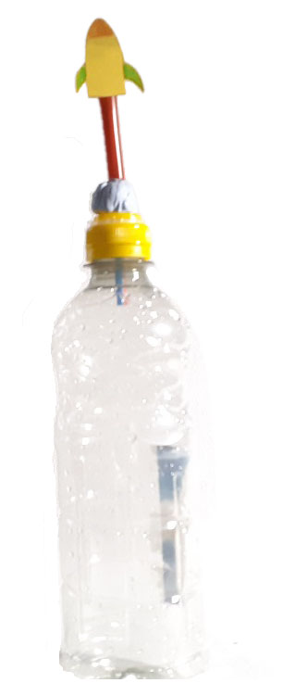
The Science
All rockets work on the same principles. Rockets in general are cylindrical objects that can be propelled to great heights or distances by some form of fuel. This propulsion is governed by Newton’s third law: Every action has an equal and opposite reaction.
That is, if a particular amount of force is applied on an object in one direction, the object in return will exert the same amount of force in the opposite direction.
This rocket is attached to a hollow tube (body) which is open at one end and sealed at the other. The body tube holding the rocket is only slightly bigger than the launch tube (straw in bottle). When you squeeze the bottle, you are forcing air out through the thinner straw. This creates pressure inside the straw holding the rocket, forcing it upwards and into the air.
The flight of the air rocket is like the flight of a bullet. The thrust is expended in one effort (squeezing the bottle) and during the flight, only its own weight and aerodynamic forces (drag/lift) affect the rocket. Adding fins to the bottom of the rocket provides some stability during flight.
The launch of an air rocket proceeds in three stages: build-up of air within the body (pressurisation), initial acceleration as it leaves the launcher followed by expulsion of the compressed air from the rear of the tube as it propels the rocket upwards.

