Slide 1




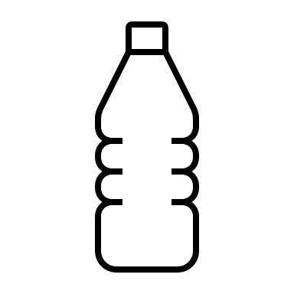


Tornado in a Bottle
What you need:
One plastic bottle with screw lid (labels removed)
Water
Food colouring or glitter
Washing up liquid
What you do:
Pour the water into the bottle, leaving about 6cm of air at the top. ​​
Add two squirts of washing up liquid. ​​
Add some glitter or food colouring. ​​
Put the lid on and screw it as tight as possible onto the bottle. The tornado will not work well unless the bottle is completely airtight. ​​
Spin the bottle by holding at the bottom and making a circular movement with your hand so that the water begins to swirl around inside the centre of your bottle.
The Science
A tornado in a bottle is generated by the spinning water. The water is responding to a force called centrifugal force. Here the water spins around forming a whirlpool, the centre of which is the ‘vortex’ which in this case is in the middle of the bottle.

